Slide 1


Punit’s Portfolio
T1A2 Assignment Presentation Slide Deck
CoderAcademy

Slide 2
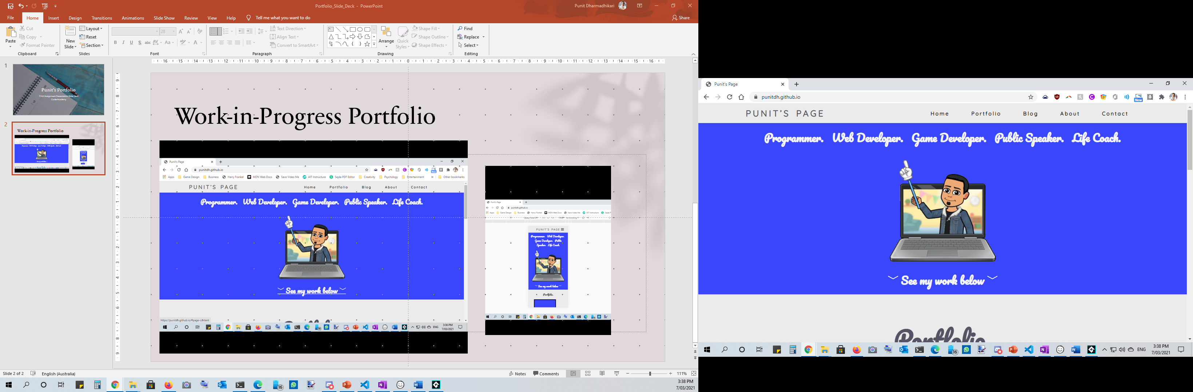
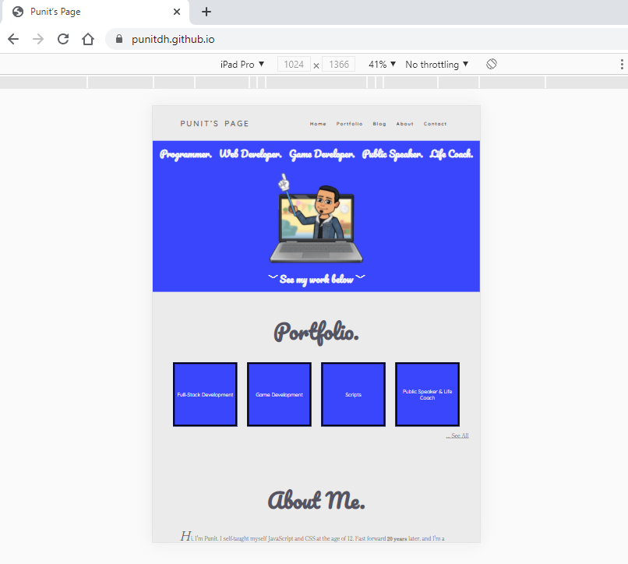
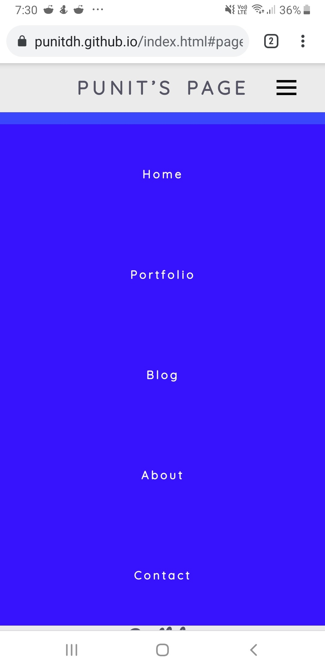
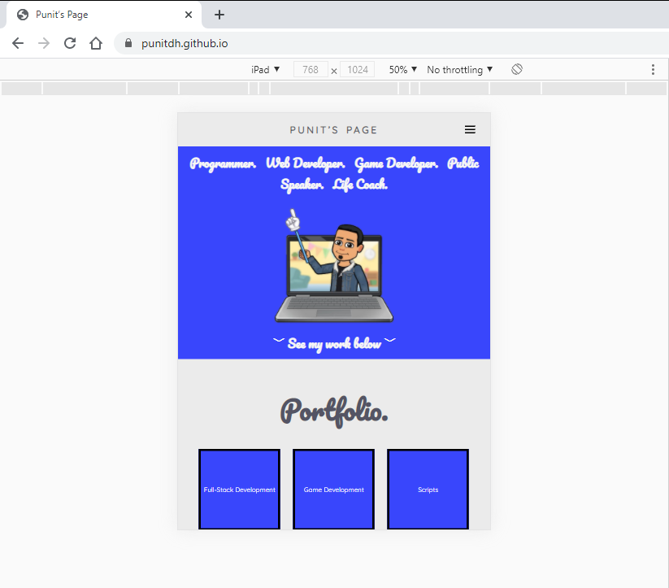
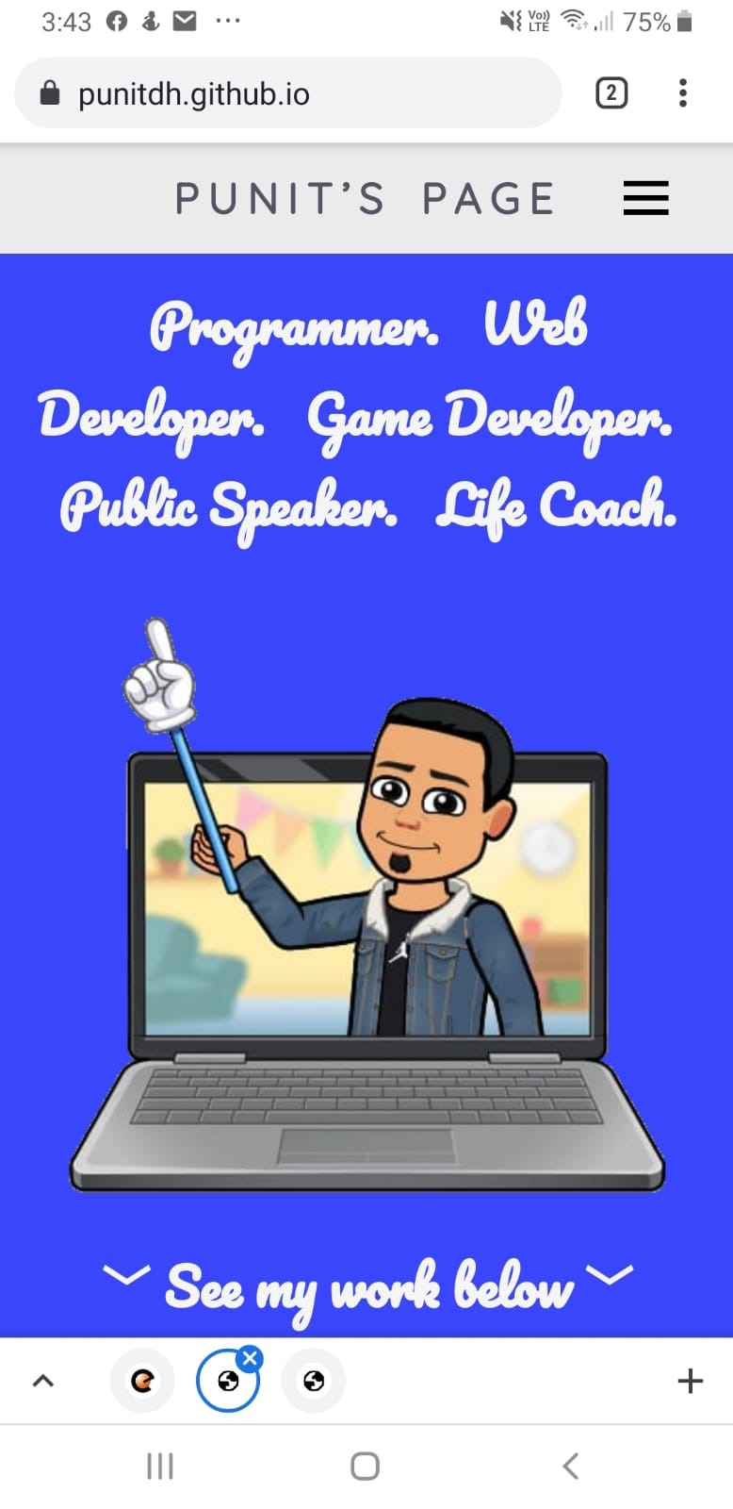
Work-in-Progress Portfolio
https://punitdh.github.io/

Slide 3
Site Map
Home page /index.html
Contact
/contact.html
#Portfolio
#About me
#Blog
Portfolio page
/portfolio.html
Resume page
/resume.html
Blog page
/blog.html

Slide 4
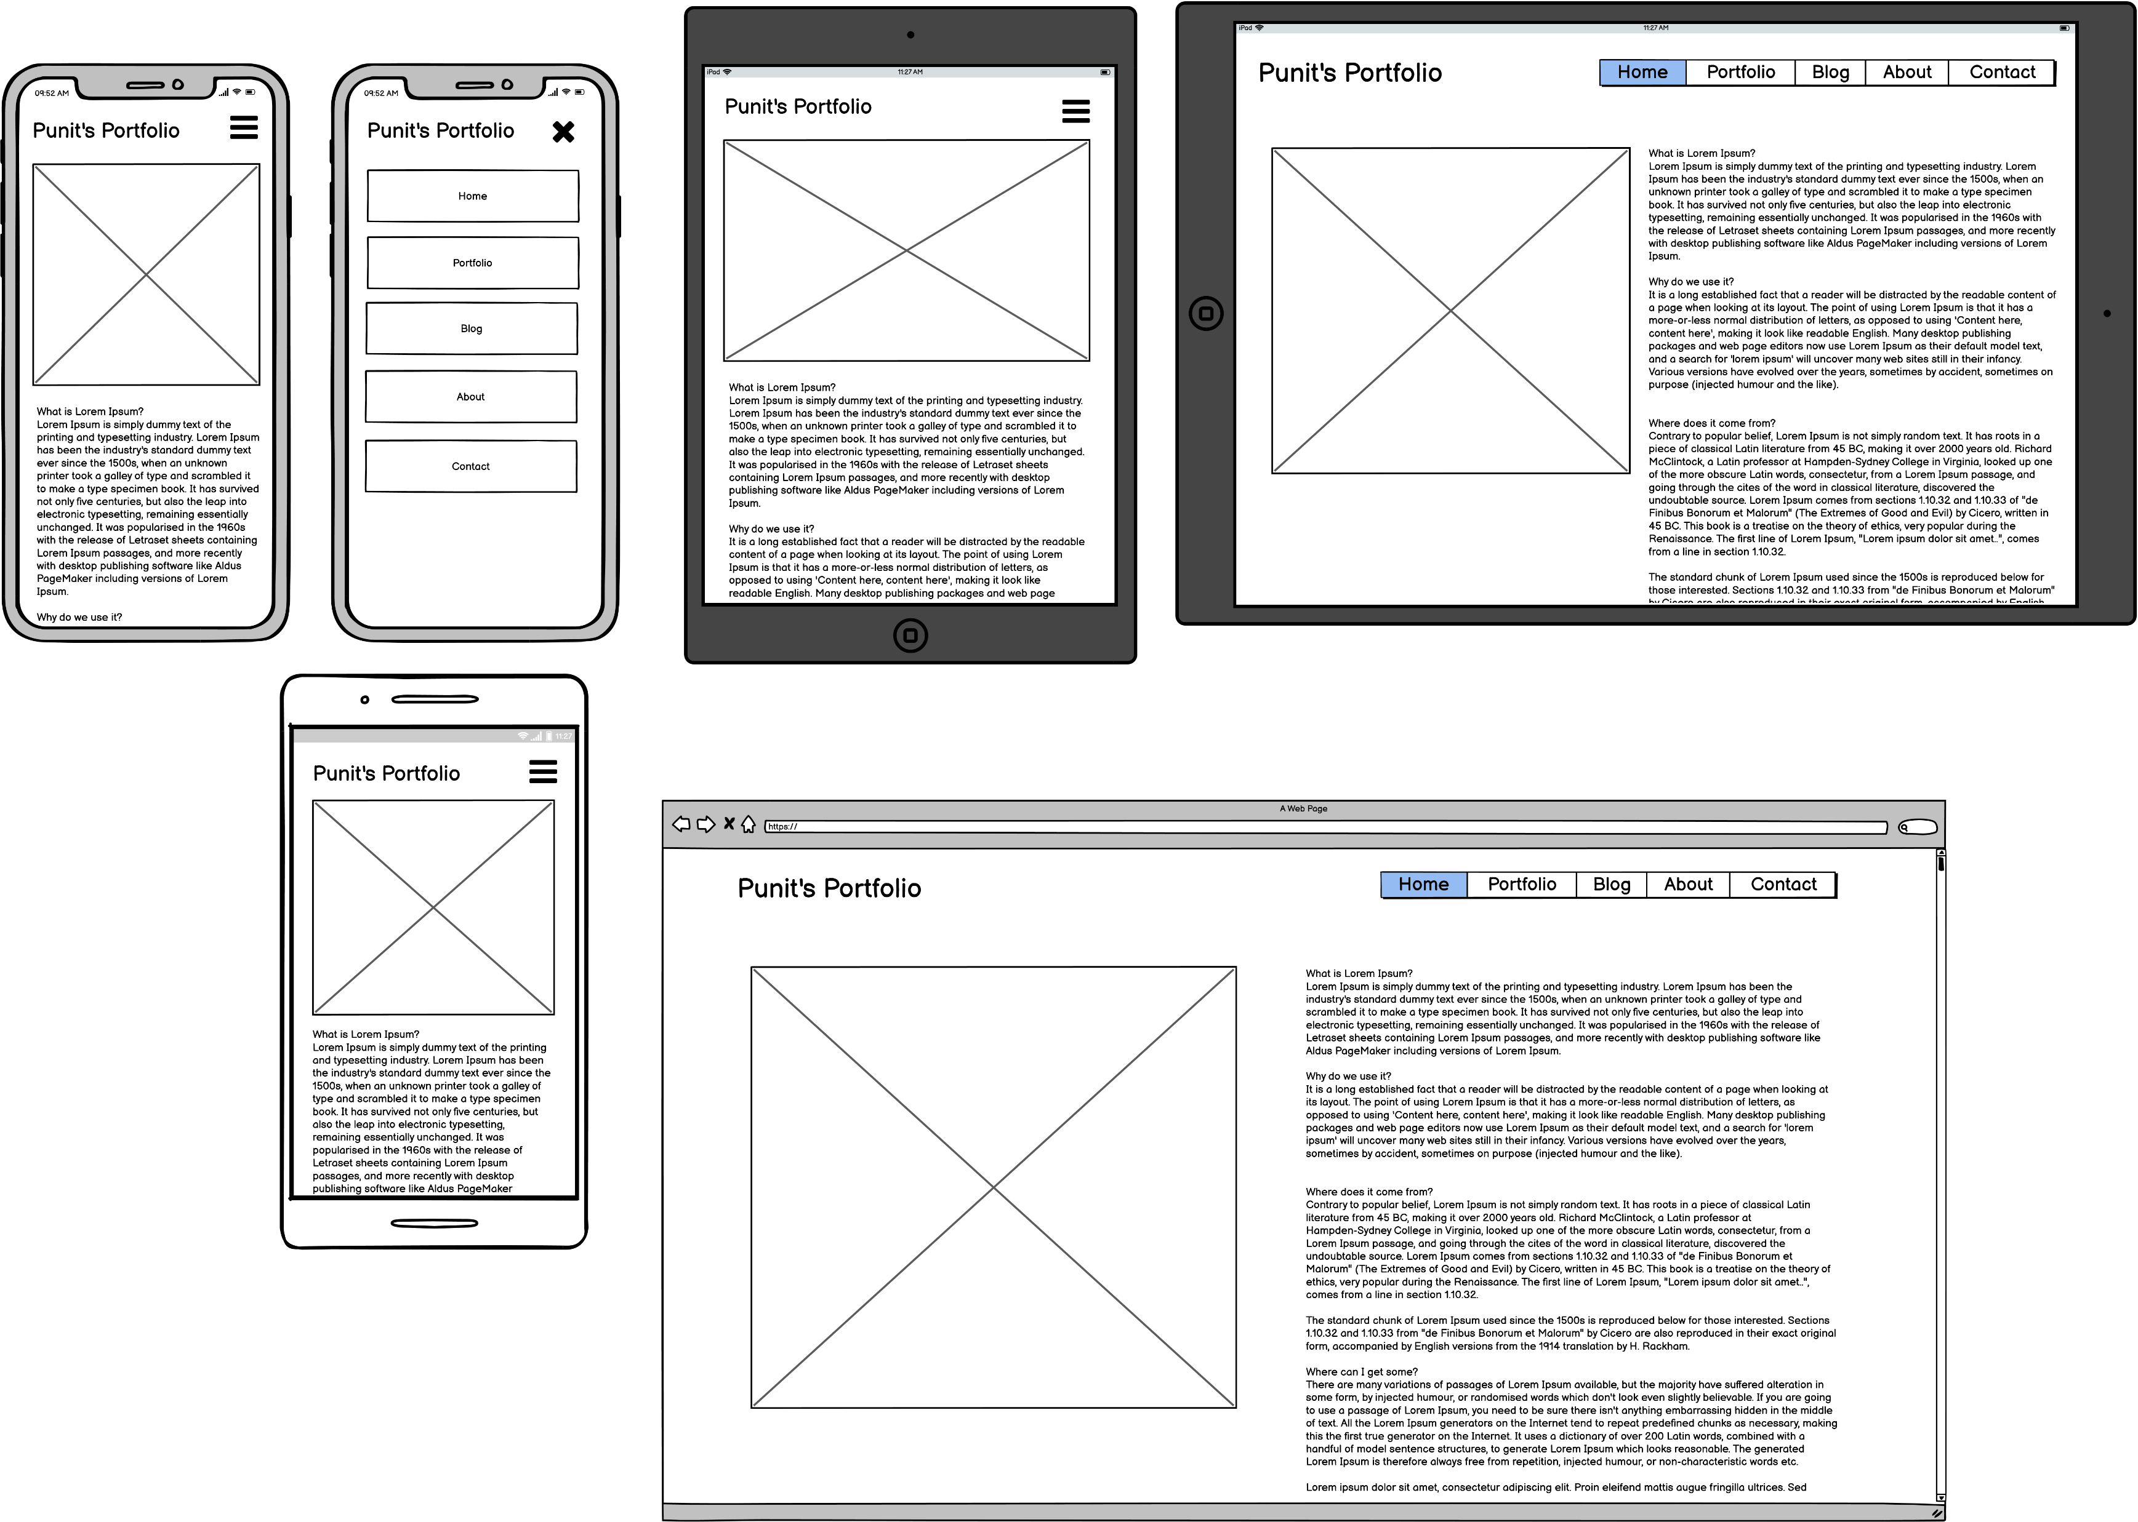
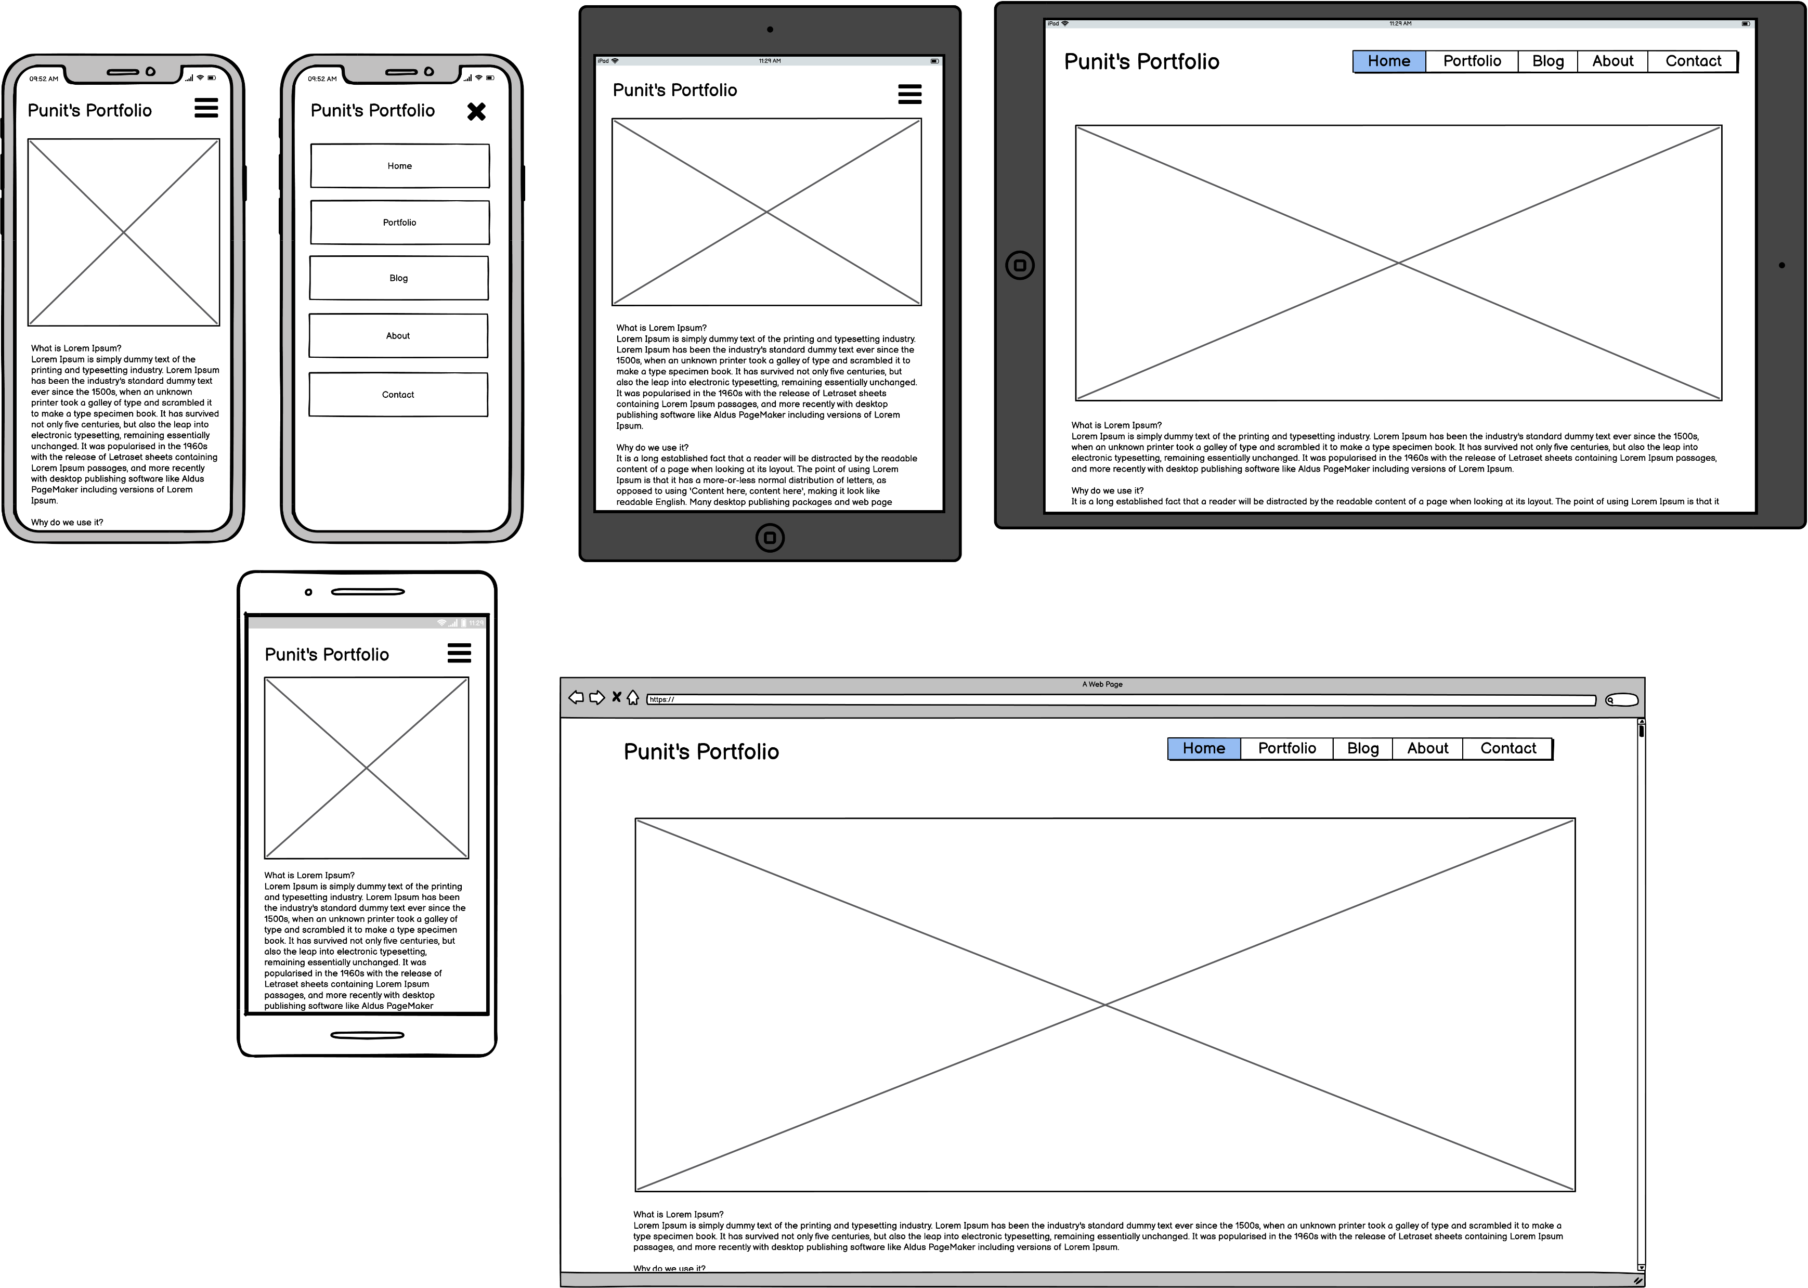
WireFrames

Slide 5
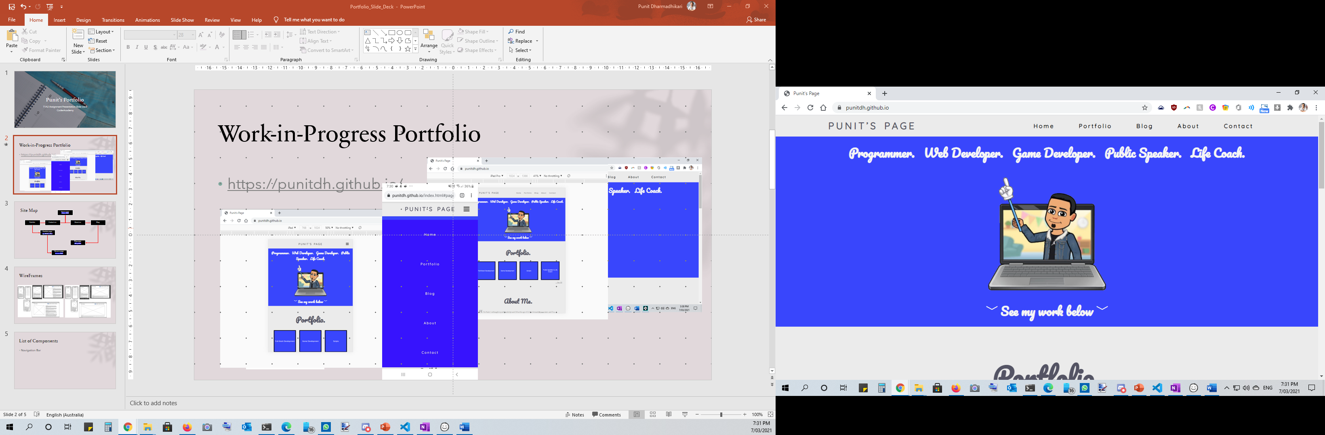
List of Components
Navigation Bar
Graphic
Mouse-over Box Buttons
Footer

Slide 6



